Slide 1



Methods
What is a method
C# OOP
Basics
SoftUni Team
Technical Trainers
Software University
http://softuni.bg

Slide 2

Table of Contents
What is a method?
Method return types
Method parameters
Overloading

Slide 3

What is a Method?

Slide 4
Simple Methods
Method named PrintHeader
Invoking the method:
void PrintHeader()
{
Console.WriteLine("----------");
}
PrintHeader();
PrintHeader();

Slide 5

Method Return Types
Return Value

Slide 6
Simple Void Method Example
void PrintLetterM()
{
Console.WriteLine("|\\ /|");
Console.WriteLine("| \\ / |");
Console.WriteLine("| \\ / |");
Console.WriteLine("| \\ / |");
}

Slide 7
Method Return Types
Method returns a result of type int
Invoking the method:
int SumNumbers(int a, int b)
{
return a + b;
}
Return a value as a result of the method call
SumNumbers(5,6); // 11
SumNumbers(5,5); // 10

Slide 8

Methods
Live Exercises in Class (Lab)

Slide 9
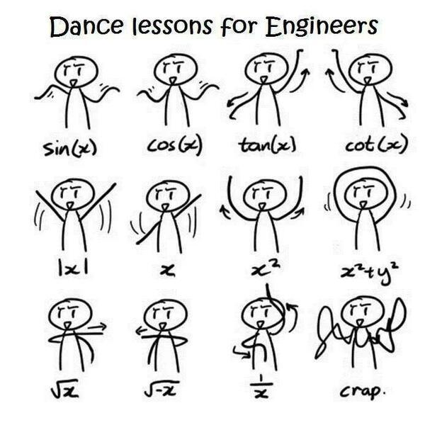
Method Parameters

Slide 10
Method Parameters
string head, string body, string tail
string Concatenate(string head, string body, string tail)
{
return head + body + tail;
}
Parameters
Invoking the method
Concatenate("Pesho", " ", "Petrov"); // Pesho Petrov
"Pesho", " ", "Petrov"
Arguments

Slide 11

Method Signature

Slide 12
Method Signature
void Main(string[] args)
{
Console.WriteLine("Hello C#!");
}

Slide 13
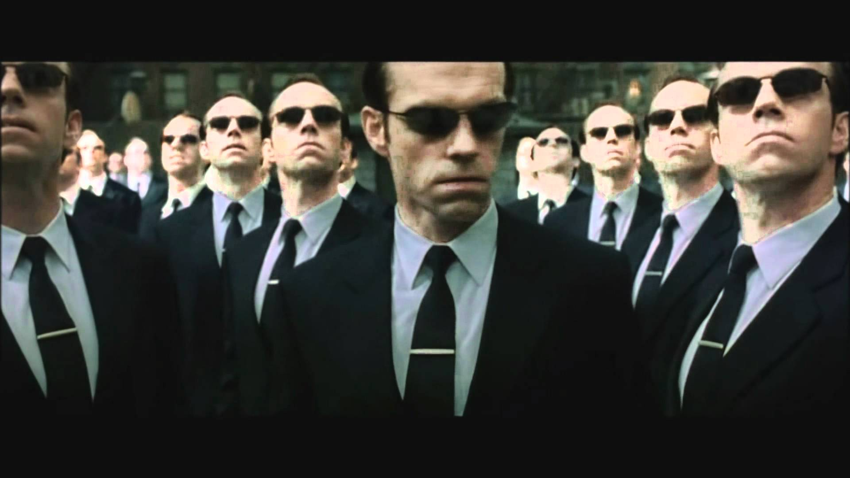
Params keyword

Slide 14
Params
void PrintNames(params string[] names)
{
//Print all given names
}
Invoking the method
PrintNames("Peter", "Steven");
PrintNames("Annie", "Peter", "George", "Sonia");
PrintNames("Lorrie");

Slide 15
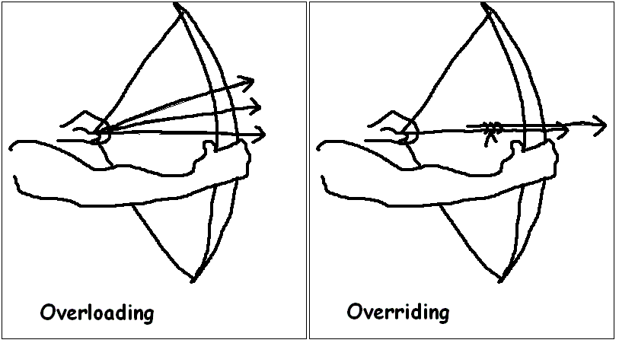
Overloading

Slide 16
Overloading Example
Similarities
- Same return type
- Same name
Differences
- Number of parameters
- Parameters type
void PrintInfo(string name)
{
//Print name
}
void PrintInfo(string name, int age)
{
//Print name and age
}

Slide 17
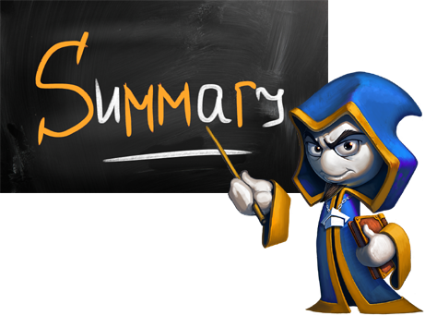
Summary
Methods are named pieces of code that can be invoked later (with parameters)
Methods could return value or they could
return void
Methods could have same name but
they must have different signature

Slide 18








Methods
https://softuni.bg/csharp-basics-oop

Slide 19
License
This course (slides, examples, demos, videos, homework, etc.) is licensed under the "Creative Commons Attribution-NonCommercial-ShareAlike 4.0 International" license
Attribution: this work may contain portions from
"Fundamentals of Computer Programming with C#" book by Svetlin Nakov & Co. under CC-BY-SA license

Slide 20






Free Trainings @ Software University
Software University Foundation – softuni.org
Software University – High-Quality Education, Profession and Job for Software Developers
softuni.bg
Software University @ Facebook
facebook.com/SoftwareUniversity
Software University @ YouTube
youtube.com/SoftwareUniversity
Software University Forums – forum.softuni.bg

